Slide 1
SCSIT
V Semester
DataBase 2
Lab. Exercise No.1:
MS SQL Server Express Edition Environment
SQL DDL

Slide 2
Getting started with SQL Server
What is SQL Server?
Creating databases
Administration
Security
Backup
Note: Will be covered again

Slide 3
Tools
Microsoft SQL Server includes a complete set of graphical tools and command prompt utilities that allow users, programmers, and administrators to:
  Administer and configure SQL Server.
  Determine the catalog information in a copy of SQL Server.
  Design and test queries for retrieving data.
  Copy, import, export, and transform data.
  Provide diagnostic information.
  Start and stop SQL Server.

Slide 4
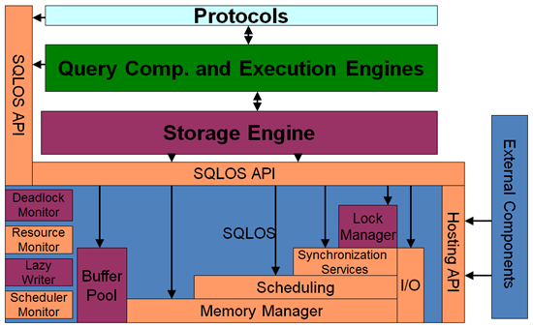
SQL Server?
RDBMS = Relational DataBase
Management Software
  Own file structure
  Own users
  Own security and protection

Slide 5
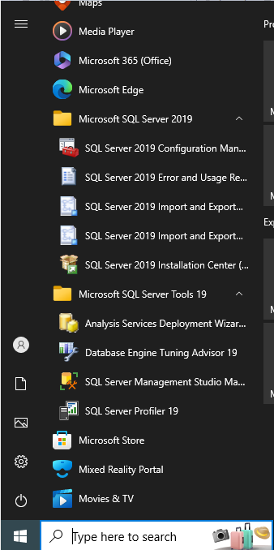
MS SQL Server
Management Studio (Express)

Slide 6
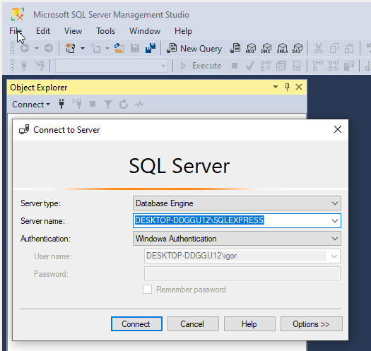
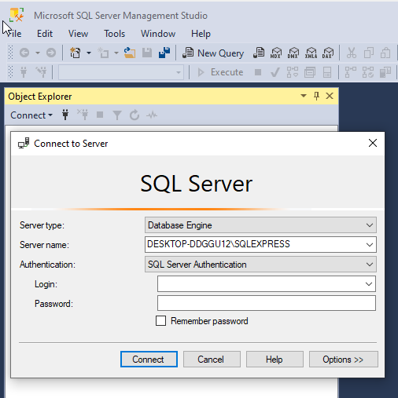
Log In

Slide 7
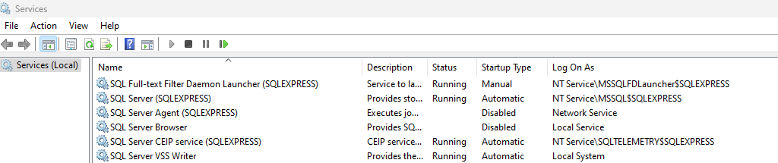
Service info ?

Slide 8
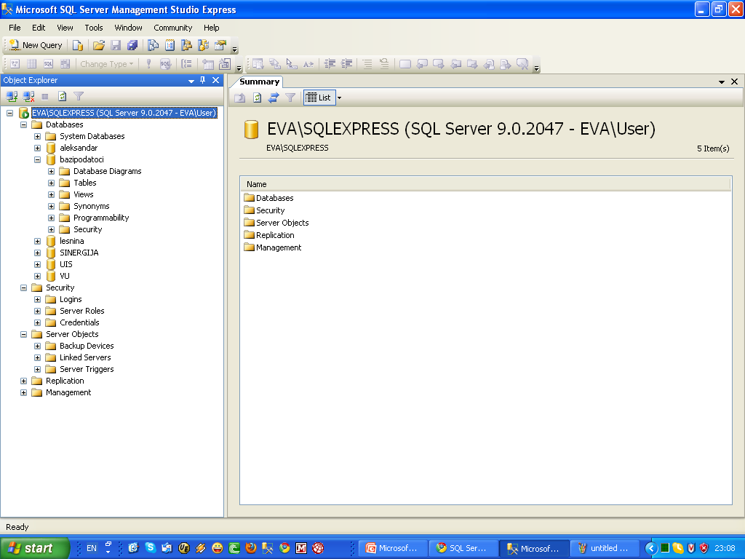
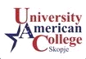
Tool strip
workspace
Object explorer

Slide 9
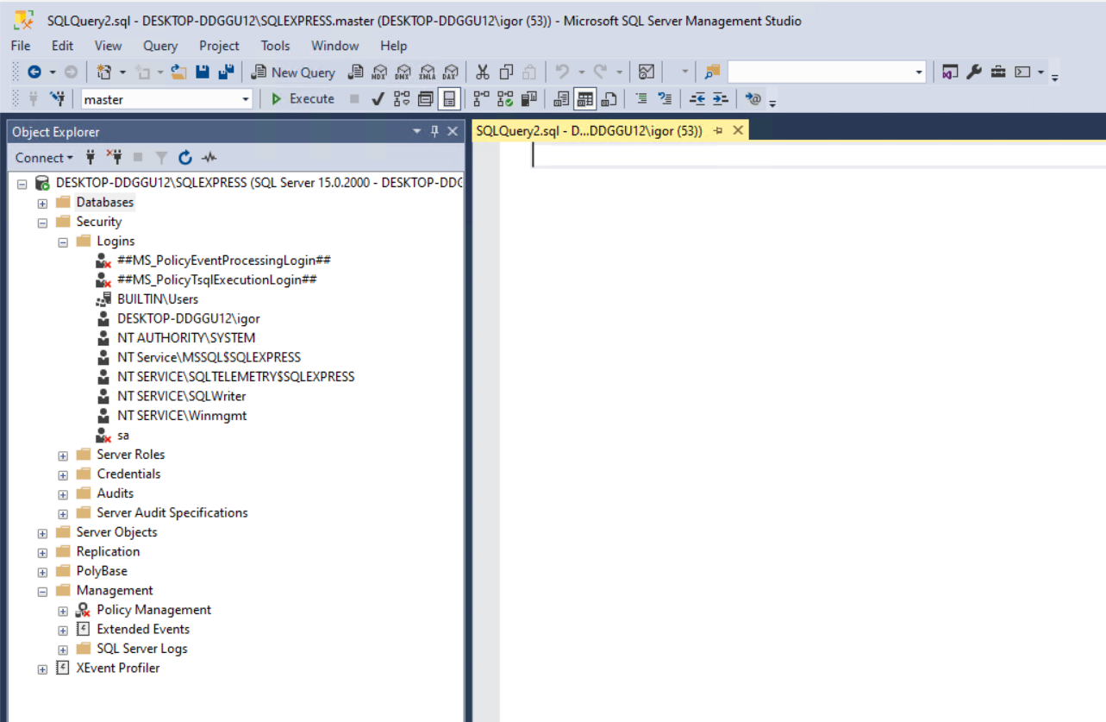
Tool strip
workspace
Object explorer

Slide 10
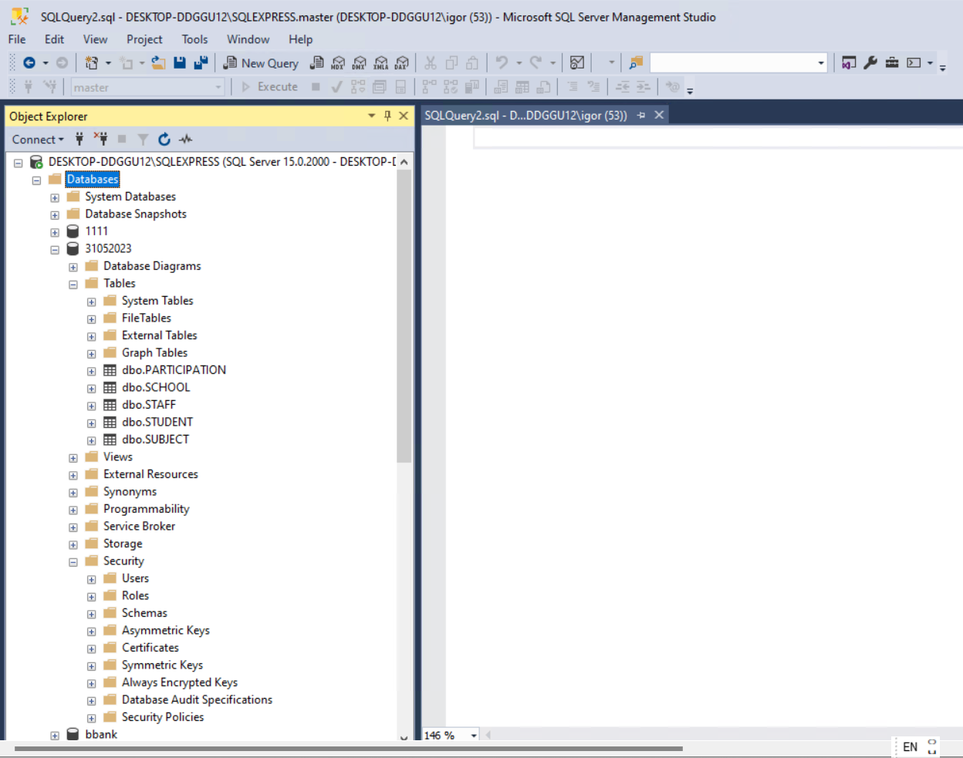
Tool strip
workspace
Object explorer

Slide 11
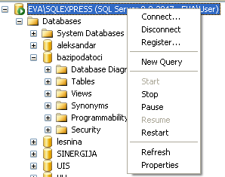
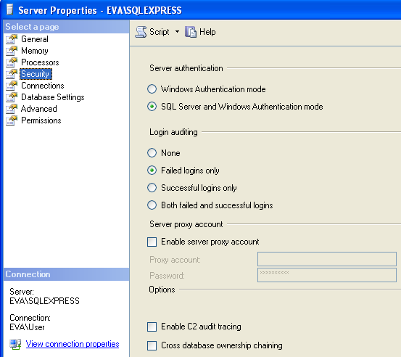
Working with SQL Server
Connect \ Disconnect
Register – rename SQL Server
Start/Stop/Pause…
Properties - Security
Security tab is used to define authentication, end product
Trusted Security Connection

Slide 12
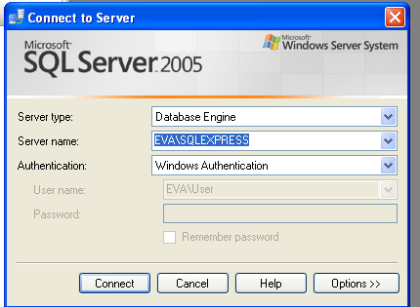
Example 1: log in to SQL Server
Click on New Query

Slide 13
Create a Database
CREATE DATABASE
Only system administrator has authorization to
execute a CREATE DATABASE command.
CREATE DATABASE <datebase_name>
Granting permissions to specific user_account (not
Administrator)
  GRANT CREATE DATABASE TO <user_account>

Slide 14
Database Objects
DATABASE
Table
Schema
View
Function
Procedure
Trigger
Scripts

Slide 15
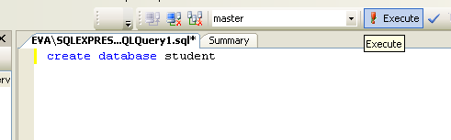

CREATE DATABASE
Press EXECUTE

Slide 16
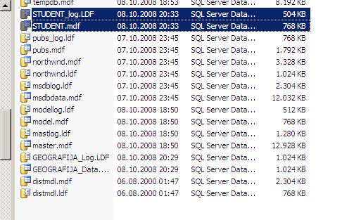
Where are Data Base Files?
Student.mdf
Student_log.LDF
Default location:
C:\Program Files\Microsoft SQL Server\MSSQL.1\MSSQL\DATA

Slide 17
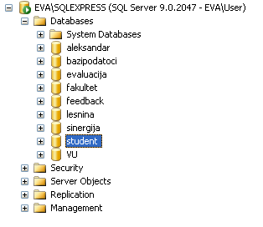
Where is Student DB in
Management Studio structure?

Slide 18
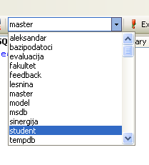
Choose DB to work with (1)

Slide 19
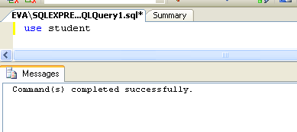
Choose DB to work with (1)
USE <database_name> + Execute

Slide 20
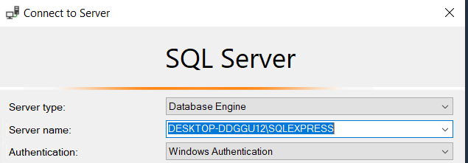
SCSIT
V Semester
DataBase 2
Lab. Exercise No. 2
GUI working interface in SQL Server

Slide 21
How to use Mng. Studio
Connect \ Disconnect
Register
Start/Stop/Pause…
Properties - Security
In Security you can define Server
Authentication type in order to
create so called Trusted Security
Connection

Slide 22
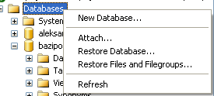
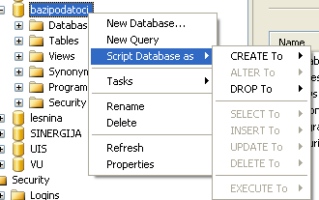
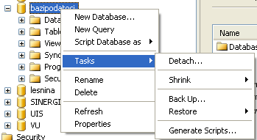
DataBase operations
New Database
Attach (*.mdf and *.ldf)
Restore (*.bak)
------------
Script DB As..
Detach
Shrink
Back up

Slide 23
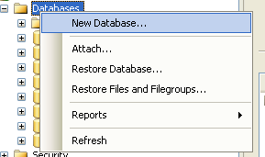
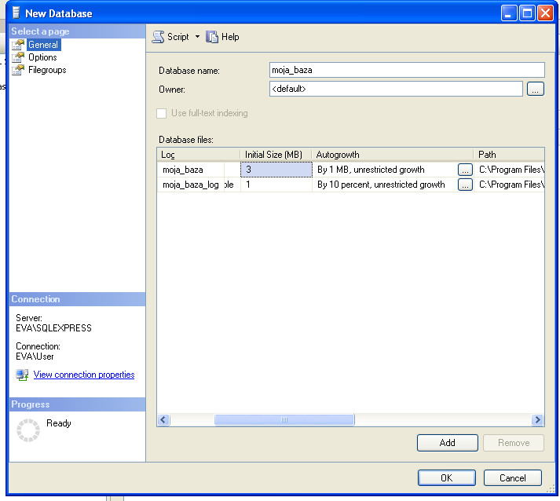
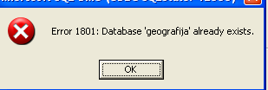
New Database
ATTENTION!!!
You can not create
database with SAME
NAME as some DB
that already exists

Slide 24
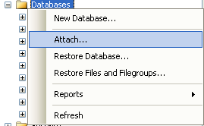
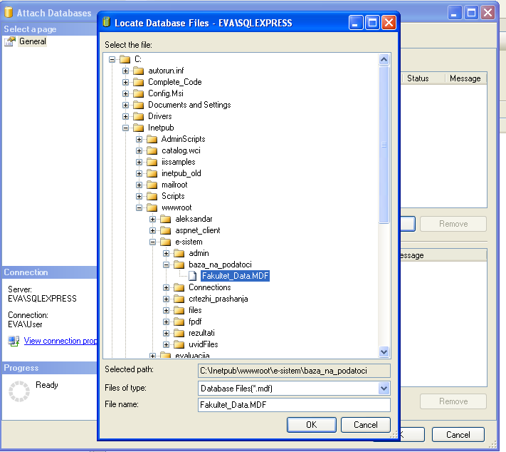
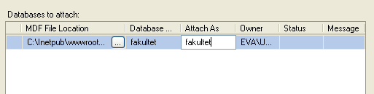
Attach
Data Base
Attention: you can not attach database with same name as some DB that
already exists. YOU NEED
To rename newly attached database
i.e. to change its logical name on
server (Attach as), or
To remove the first database (detach)
and then to attach the new one

Slide 25

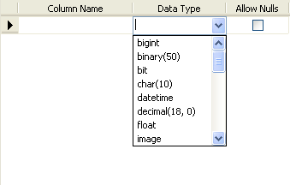

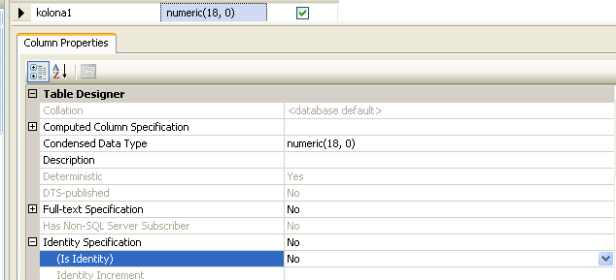
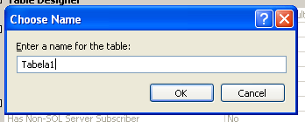

Slide 26
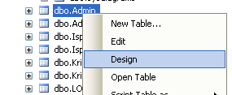
Modify Table structure
You will get the same window as in
New Table…, step 2
After you’ll make some changes, you
MUST save the modified table
structure (ctrl+S)

Slide 27
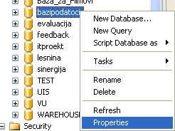
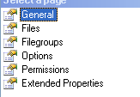
Database properties
General: Basic database information
  name, size, owner, no. of users
  Last backup
  Collation: Macedonian_FYROM_90_CI_AS
    CI = case-insensitive, CS = case-sensitive
    AI = accent-insensitive AS = accent-sensitive
Files:
  Database files name and location
  Ability to ASSING DB owner
    This operation is usual after attaching DB that is taken from
    another server. Always check whether your newly attached DB has proper owner
  Options: setting up parameters for optimal DB usage
    Collation, compatibility level, read-only, restrict access….

Slide 28
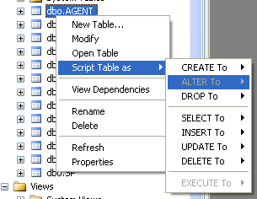
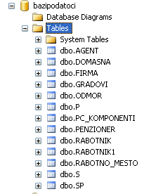
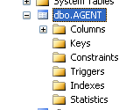
Tables– access and commands

Slide 29
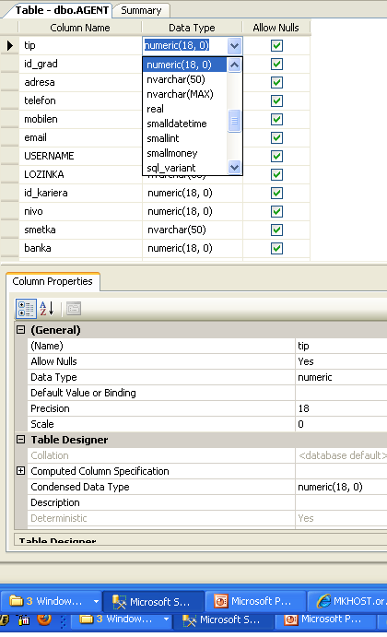
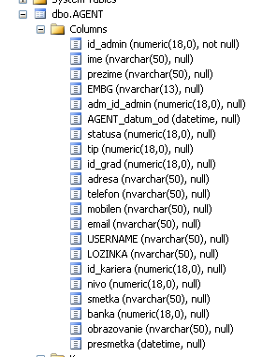

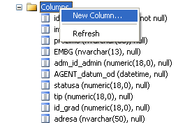
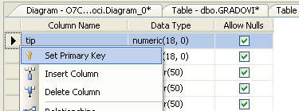
Tables–
Access and commands

Slide 30
Scripts
For every DB component, you can create script for
  Creation - CREATE
  Modification - ALTER
  Deletion - DROP
  For tables and views, there is a possibility for creation of scripts for INSERT, UPDATE, SELECT and DELETE operations
  For procedures, there is a possibility for creation of scripts for
  their execution, i.e. EXECUTE
A Script can be
  Created in new Query Editor Window
  Saved in file (.sql)
  Save to Clipboard (i.е. memory)

Slide 31
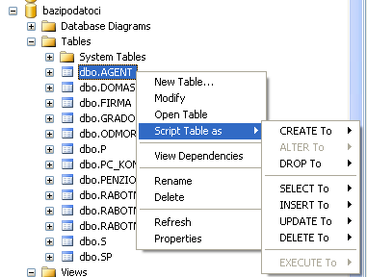
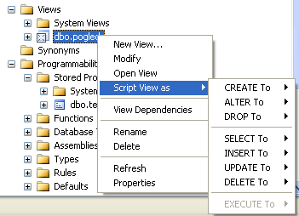
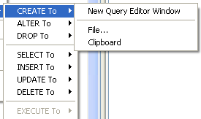
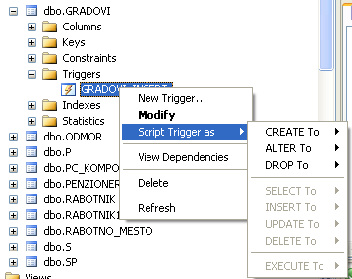
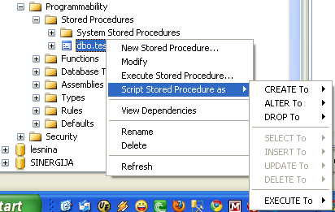
Create/Save script

Slide 32
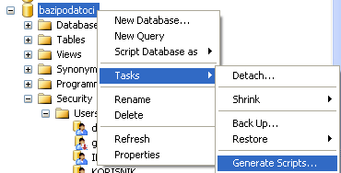
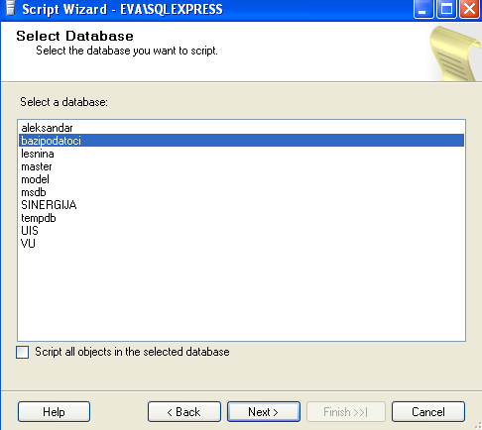
DB Script
Choose DB

Slide 33
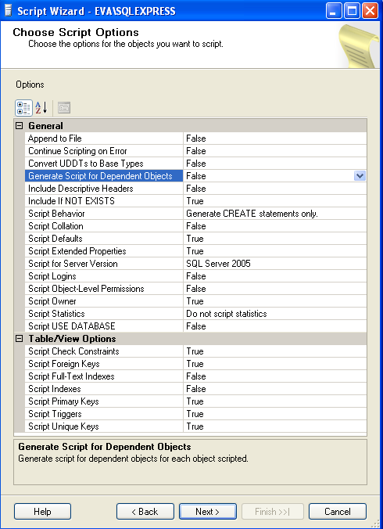
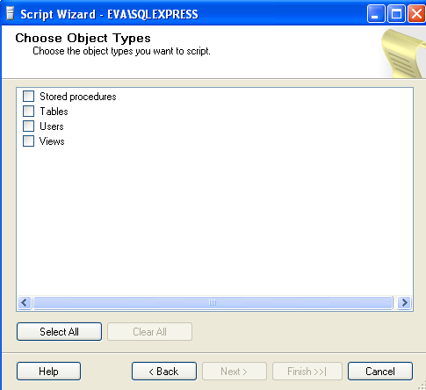
Define script options (global)
Choose object types that will be scripted

Slide 34
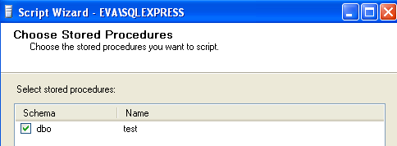



Screens for choosing specific components for scripting (tables, procedures, views, users)

Slide 35


Choose how the script should be created/saved
Selection review

Slide 36


Script generation process
Last window, report for the generation process

Slide 37

Script content

Slide 38
BACK-UP database file
Has the database objects definition
Has all constraints and relations between DB objects
Has ALL DB Table data
This file is used for restoration of the old state of the existing Database (i.e. DB that is attached on the server) over its current state.
Definition restoration
Data restoration

Slide 39



Back up DB (.bak)
Options:
1. Additional parameters for back-up file creation (optional)
General:
1. Choose DB
2. Write file name
3. Create back-up scheduler (optional)
4. Choose location for .bak file

Slide 40

Example + RESTORE
Create desktop folder, DB Backup
Create Backup for Obrazovanie DB into folder DB Backup.
Try to make DataBase Restore operation.
Conclusion:
We can make RESTORE only if Data Base is Defined in SQL Server (it can be empty (Check “Force restore over existing DB”
option)).
You can not make RESTORE if DataBase doesn’t exist

Slide 41


DETACH DataBase
For manual backup of database.
After DETACH, you can COPY-PASTE *.MDF and *.LDF files
from their original location to some other location

